Slide 1

Thermal-Hydraulic performance analysis of chip cooling in electronic devices using Machine Learning
Tushar Kumar Mishra
18MF3IM35
Supervisor: Prof Chirodeep Bakli
Mentor: Mr. Avinash Kumar
Indian Institute Of Technology Kharagpur

Slide 2
Electronics Industry
Conventional Cooling Systems
New Cooling Systems
Introduction & Overview
Current Scenario
Challenges
Description
Limitations
Motivation for a better thermal management system
New Technology
Liquid Cooling
Liquid Cooling with DL- MCHS

Slide 3
Thermal-Hydraulic performance analysis of chip cooling in electronic devices using Machine Learning
Problem Statement
1
Objectives of the Study.
2
Current Advancements in the Field
3

Slide 4
Theory, Modeling, and Methodology
Numerical Modelling
C
C
Theoretical Approach.
A
B
Experimental Setup and Geometrical Considerations.

Slide 5
Theoretical Approach
A three-dimensional solid–fluid conjugate model
Navier–Stokes equations with Boundary conditions and Energy equations: (Mass, Momentum, and Energy)
Solved numerically using finite-volume based CFD package, ANSYS FLUENT

Slide 6
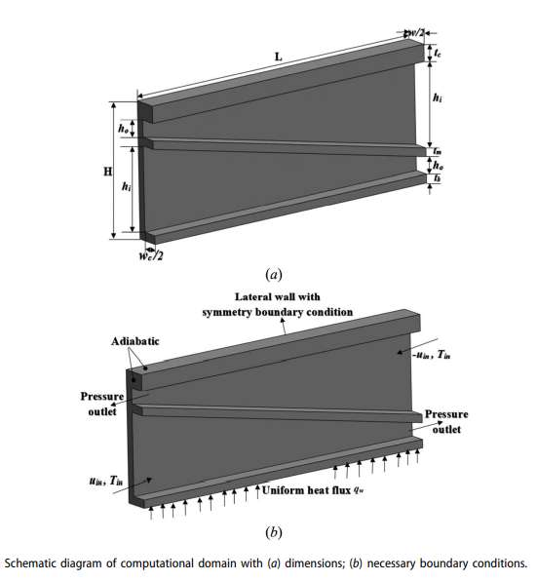
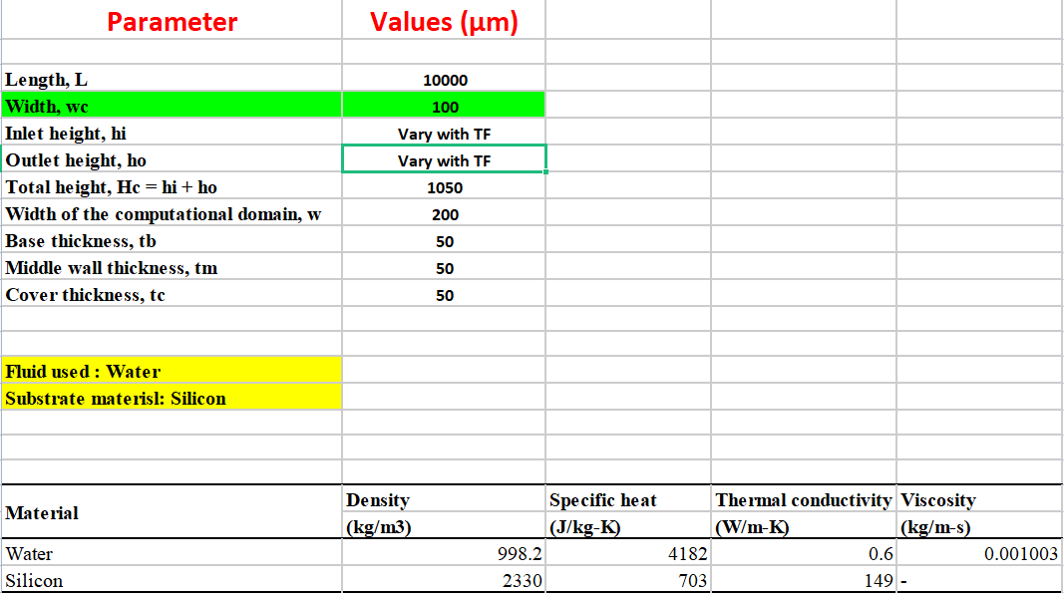
Experimental Setup and Geometrical Considerations

Slide 7
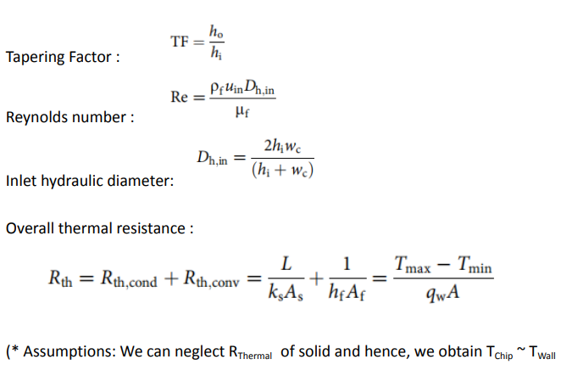
Numerical Modelling

Slide 8
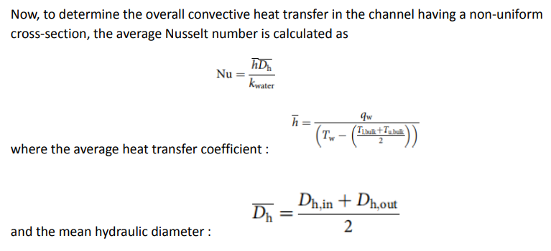
Numerical Modelling and Dataset Generation

Slide 9
Why Choose Machine Learning?
Generated Labelled Dataset- Self learning
Optimization Problem
Overcoming shortcomings of theoretical and numerical approaches

Slide 10
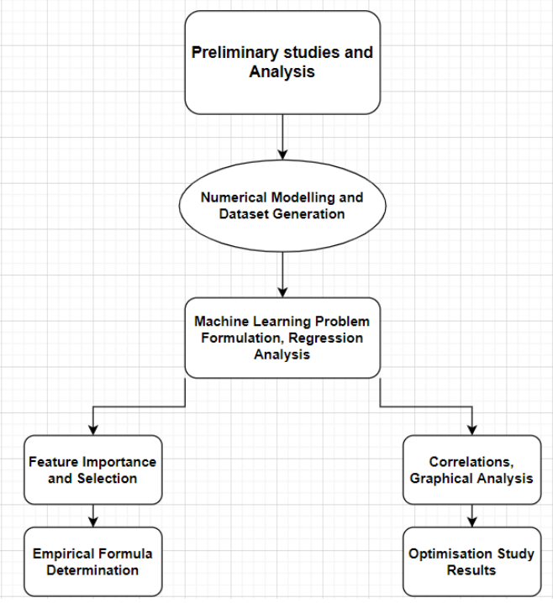
Process Flow

Slide 11
ML Problem Formulation
Multivariate Regression Problem
Quantifying the effect of various numerical features on Nusselt Number
Dataset and Exploratory Data Analysis

Slide 12
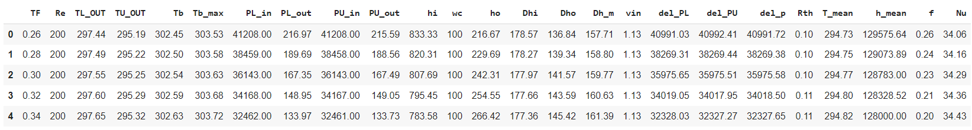
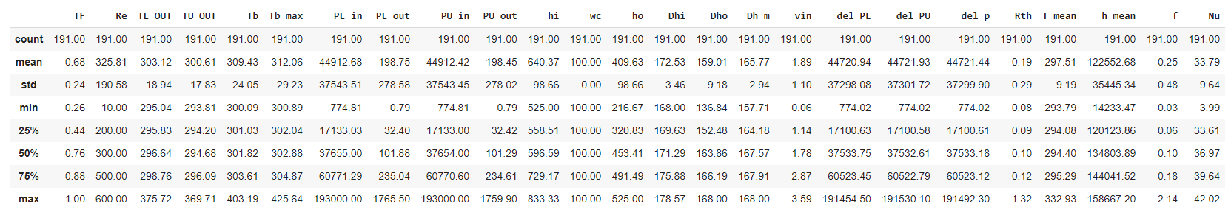
Dataset

Slide 13
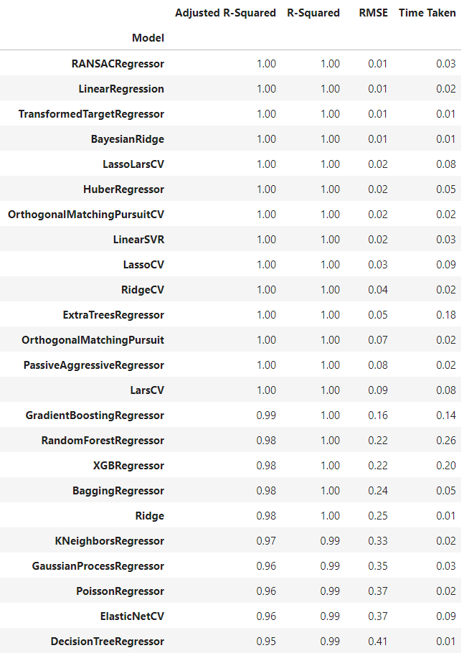
Lazy Regressor
Regressors for all Baseline ML Models in scikit learn
Selecting top performing models and tuning

Slide 14
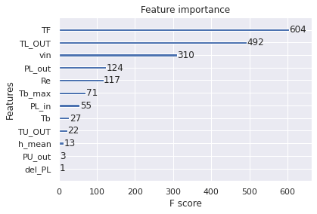
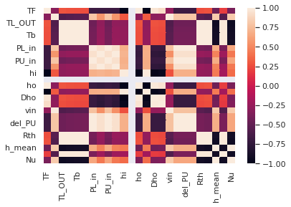
ML Methodology

Slide 15
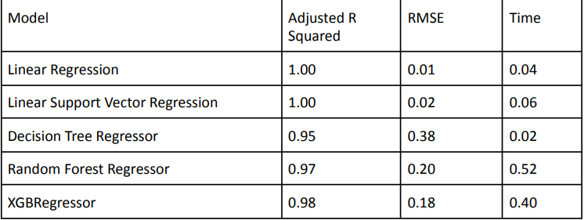
Results
Empirical Formula Determination
Nu = -2.93235987*TF - -0.25346334* Tb + 0.02287909* Re

Slide 16
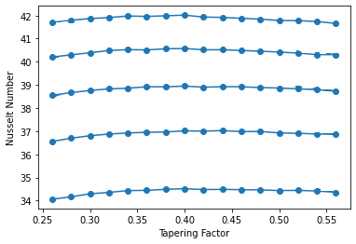
Results
Maximum Nusselt Number: 41.99 at TF=0.39 with Reynolds number, Re=600

Slide 17
Conclusion
Variation of Nusselt Number with numerical features
Optimum Nusselt number value of 41.99 at TF=0.39
Empirical Formula Determination

Slide 18
Future Scope
Eventual Aim
Variation with Geometry, conduction, pumping power, friction and fluid properties

Slide 19
Thank You
QnA

